Slide 1
UNECE-Eurostat Work Session on Migration Statistics
29 - 31 October 2019
What do users of migration statistics expect from statisticians?
The EECCA users perspective
Olga Chudinovskikh
Lomonosov Moscow State University

Slide 2
The EECCA –is an area of large-scale migration processes, it includes both migrants sending and receiving countries
Russia and Ukraine are formally among the top-ten migrant receiving countries in terms of the stock of “foreign born” population
Volume of annual flows of long-term migration exceeds 500 thousand people, moving mainly within the region (est.)
Temporary migration dominates and migration for work is the most typical feature: every year several million persons are involved into labour migration (only Russia every year receives > 5 million of potential workers).
Migrants’ remittances reach up to 30% to GDP in Kyrgyzstan and Tajikistan (WB 2019 Oct. est.)
Russia is among the top-ten countries receiving foreign students
It means that migration is in focus of national interests .
Do we know much about this phenomenon??

Slide 3
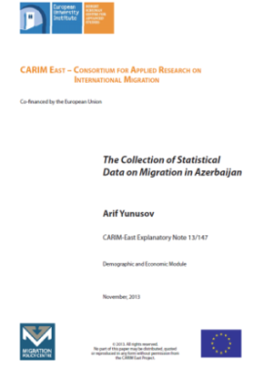
Many initiatives (incl. regional) have been undertaken, but the situation in the EECCA area is changing very slowly and not obligatorily for better
While speaking about users’ needs in statistics on migration it is difficult to avoid well known and already discussed facts
As all other users in sending and receiving countries we want to have data on flows and stocks, we want to study reasons and consequences of migration, migrants' integration, their position on the labour market, naturalization process, situation about women and children…. etc. for both descriptive papers and in-depth analysis. And we want all relevant information from different sources be processed and published in understandable and convenient form ……
This presentation:
is not a exhaustive review of available data sources and types of statistics in individual countries of EECCA (including quality issues)
highlights the most typical and important problems that regional users face;
is based on personal experience of the author as well as
incorporates ideas expressed by colleagues from Ukraine, Belarus, Georgia , Moldova , Armenia, Uzbekistan , Kazakhstan , the Russian Federation and Eurasian economic commission
Its goal is not to criticize statistical or other agencies and some officials in individual countries, but to discuss the problems
Info on the RF might be more detailed
OSCE – IOM 2014
UNECE 2011, 2016
CARIM-East, country notes: Armenia, Azerbaijan, Georgia, Ukraine, Moldova, Belarus
Center for Global Development 2009
ESCAP 2016
EUROSTAT 2018
Global Migration Group. 2017

Slide 4
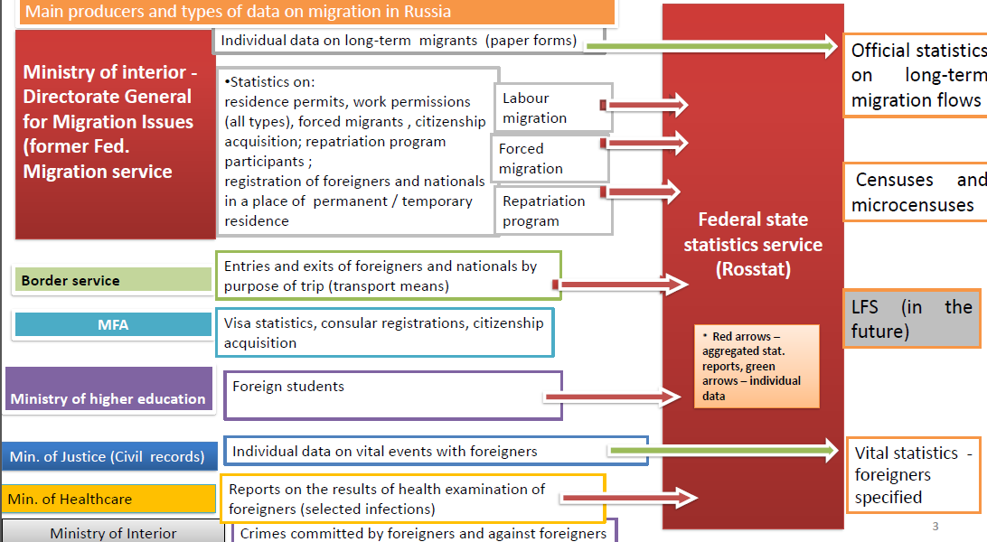
Statisticians or data owners/(producers)? That is not the same……
(Example of the Russian Federation)

Slide 5
Data on flows and stocks most often comes from different sources. Data driven analysis rather than demand driven statistics. Data availability differs
No longitudinal surveys
Censuses – were conducted in most cases, core questions are included + q on absent household members .
Administrative statistics
Limited variety of types (mainly- registration based statistics of flows)
Surveys (national and large scale)
Armenia | 2001 | 2011 | X | X
Azerbaijan | 1999 | 2009 |  | X
Belarus | 1999 | 2009 | ? | X
Georgia | 2002 | 2014 |  | X
Kazakhstan | 1999 | 2009 |  | X
Kyrgyzstan | 1999 | 2009 | X | X
Moldova | 2004 | 2014 | X | X
Russia | 2002 | 2010 |  | X
Tajikistan | 2000 | 2010 | X | X
Turkmenistan | 1995 | 2012 |  | X
Ukraine | 2001 |  | X | Х
Uzbekistan |  |  |  | X
Microdata is available not everywhere

Slide 6
Most important issues mentioned by national users
(sequence does not mean ranking by significance ) | NSA | Other data owners
Absence of certain types of data (and necessity to rely on indirect methods of estimation) | X | X
Information exists and available, but quality is unsatisfactory | X | X
Statistics is not disaggregated by necessary variables , or combinations are not sufficient | X | X
No info on status change | n/applic. | X
No time series (necessity to collect info from separate files) |  | X
Lack of information on migration within free-mobility zone - administrative records are very incomplete, no surveys in receiving countries | X | X
Absence of specialized large-scale sample surveys of migration in the main receiving countries | X | n/applic.
Access to admin data is often either prohibited or very difficult (bureaucratic), requests are not welcomed. | n/applic. | X
Limited access to microdata of censuses and surveys | X | n/applic.
Deficit of “stories” – including analysis of methodology development, attempts to check data quality via compilation data from different sources, deficit of analytical notes or papers on the websites of data producers, even descriptive reports are a rare practice | X | X
Unwillingness of admin. agencies (especially – the “new players” ) to produce or publish migration related statistics : data with migration variables is not processed. Lack of tradition to develop and publish a variety of statistics | n/applic. | X
Lack in coordination between NSA and admin. agencies and between admin. agencies themselves | X | X
Unsatisfactory form of statistics presentation: non-convenient navigation through the websites, difficulties in finding necessary data (data is not classified by topic – only “migration” in general), Information on different types of migration should be searched for in different places; it is not always possible to get info. in English or other languages. Poor visualization , old-fashioned design of available tables. | X | X

Slide 7
Some quotes from national users’ comments:
“When we address questions to administrative data owners (managers of different registries), the answer is always the same: first, migration statistics is not their task, and if the government considers such a task important, it needs money, which, as always, is not available. In addition, registries accumulate personal data, and their safety is a sacred matter, you can not take any risks”.
“Basic problems and needs about statistics on migration in our country were described in analytical report in 2014. None of our recommendations have been implemented”.
«…..The main problem is not even absence of statistics, but its conscious closure»
«Access to (NSA’s) information is the main problem. Only the most general numbers are published. Probably more detailed statistics are produced, but they are not available”
…..”Information exists, but not available… for technical / technological reasons. If you do not know how to reach needed section, you will not find it. No instructions... That's it! The impression that it is made in order that as few people as possible could receive it”….
«….. Again my request for border crossing statistics was refused, and there was a comment in the refusal letter that I could challenge their decision in court….”
“Statistics are scarce, there are no time series with retrospective data, as if data collection began only after reorganization (of migration service). Published data is not disaggregated by many necessary and interesting for many users characteristics of migrants ( age, sex, e purpose of entry, etc.)” (*Available at a request)

Slide 8
Own experience (the slide should not be understood as a list of personal “old grudges”)
Administrative agencies:
A very bureaucratic procedure of request – official letter from university needed, long time to wait,
calls to ask if data is ready, discussion (not always possible) on completeness and quality of provided information…..
Agencies provide scanned images instead of tables – we had to enter all info manually (once again)
Data is not disaggregated even by countries - just one number – the sum of procedures in the reporting
year, (no clear reasons why : “we think, that will be enough for you”)
Data requested for several years provided in total for the period but not by years (with weird explanation that software does not allow to extract table for one year)
Instead of file with database functions - very convenient for work, the producer provided plain tables with disabled DB function (explanation - “this form is for service use , if you need more details – send us as new request”)
Ministry of health did not react to our question (official request) about possibility to process data on place of education and training of health workers from Federal Health workers Registry . (We wanted to study migration of foreign-trained health workers)
Pension Fund (although being polite) wrote that the data we asked about “is not collected as not having practical implementation”. (We asked on info on how many people started receiving Russian pension after citizenship acquisition since it is very popular among residents of some foreign countries)
Stat. agency:
Recommendations to publish retrospectively adjusted statistics of labour migration for 1994-2010 were ignored (the users continue to work with data based on absolutely incorrect methodology)
It was extremely difficult to persuade the officials that LFS can be used for migration measurement and research (Russian LFS conducted since 1994, only in 2019 question of country of birth and year of arrival were included)
To be continued…..

Slide 9
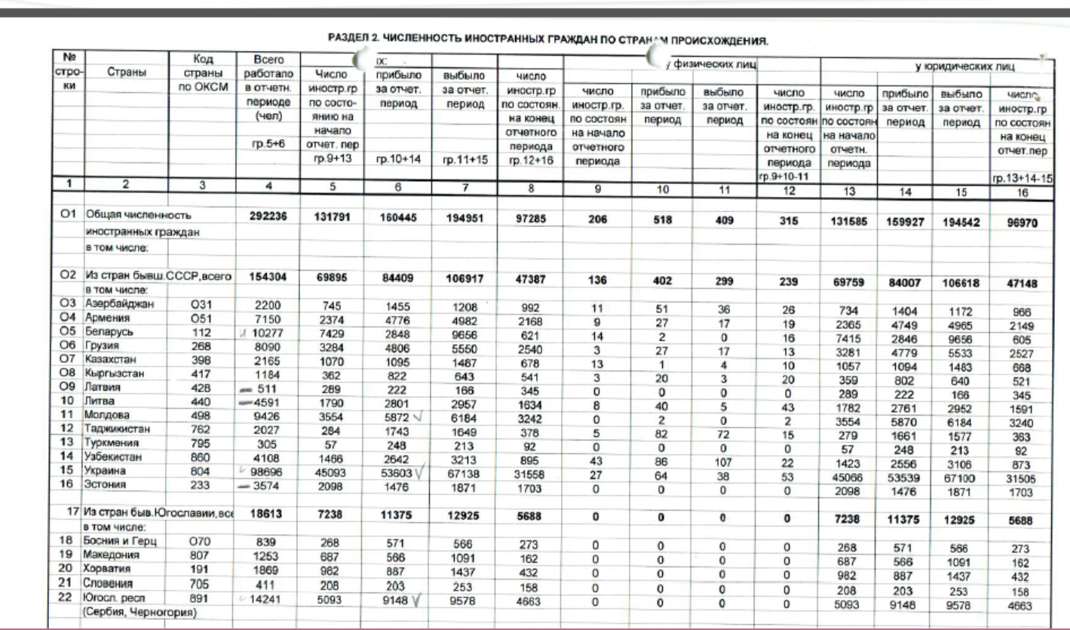
Non-machine readable format (of a very extensive statistical report)

Slide 10
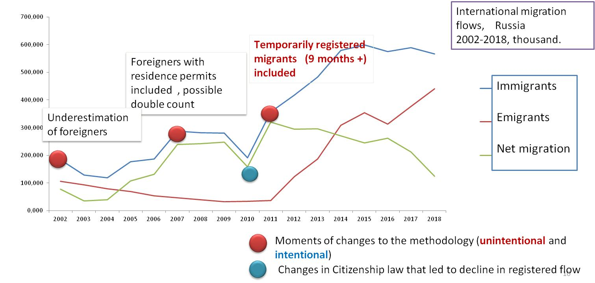
Quality issues (example of statistics of long-term flows in Russia) dynamics of long-term migration in Russia depends on external factors no less than on the migration itself. External factors – inconsistency in interaction with the Ministry of internal Affairs, gaps in the regulatory framework, technological obstacles .
Since 2011 emigration is counted automatically – when registration expires

Slide 11
Quality issues (continued). Temporary migrants prevail. Type of registration of long-term international migrants , RF, 2012-2018, % , yellow – temporary, green – permanent .
Immigrants
Emigrants

Slide 12
Quality issues (continued). The new methodology (includes temporary migrants registered for 9months +):
Is based on a set of simplifying assumptions , that might be not correct (and lead both to underestimation or double count)
Led to absolute incomparability with statistics collected in the countries sending migrants to the RF,
Broke the time series (incomparability with previous years)
Cannot guarantee correct measurement of migration flows if data is not adjusted with administrative records of migration authorities
Assumption | Doubt | Result
All migrants register immediately for 9+ months | Not obligatorily – many can register many times for shorter periods and accumulated period will exceed 9 months | Undercount of both in and out-migrants
All migrants stay until registration expires | Not true , early departures are rather numerous , new arrival and registration are possible | Undercount of early departures and new arrivals , double count of same people
All migrants “emigrate” to the same country they came from | No guarantee | Errors in distribution of emigrants by destinations

Slide 13
Quality issues (continued). Problems with migrants’ characteristics:
New methodology led to considerable increase in share of foreigners both in in- and out- flows, the latest is not typical for emigration
Reasons for out-migration are fictitious because , since 2017 majority are considered to “return to the previous place of residence”
% of foreigners in flows of international migration, RF, 2002-2018
of foreigners among in-migrants and
out-migrants

Slide 14
Example of the LFS of the Russian Federation , conducted since 1994, around 900 000 respondents per year
Quality issues
Mid-year population of foreigners with residence permits and the foreigners (1 year of residence) covered by the LFS, Russia, 2013-2015, thousands
Till 2019
No questions of country of birth and year of arrival
Question on citizenship with 3 options of answer – Russian / other / both
No questions on incomes (so far)
Module 2019:
What country were you born in?
In what country did you live in 1992?
How long have you been continuously living in Russia?
Less than 3 months
From 3 months to 1 year
From 1 year to 5 years
More than 5 years
4. What was the main reason for your arrival in Russia?
Work
Study
Family circumstances
Moving to permanent residence
Unfortunate situation in their own country
etc
In accordance with Migration service data stock of foreigners (with different statuses) staying in Russia > 1 year in 2015 amounted at approx. 3,5 million . LFS (weighted) covered around 355 thousand. Stock of lawful residents with residence permits in comparable age = 784 thousand

Slide 15
Concluding remarks 1 (general considerations)
Status quo of the availability and quality of data in the EECCA region is not absolutely satisfactory. In many cases available data is enough only to general description of current trends , a lot of important data needed for more fundamental studies is either missing or not available.
Access to statistics is one of the main problems data users meet with in the region of EECA . It is not easy to solve the problem due to institutional , political and technical barriers and circumstances, (but we should not give up)
Many data owners are not involved into production of statistics and are rare guests at the meetings like we are having today. It is necessary to involve them into the orbit of statistics production and dissemination through training courses , seminars etc. to broaden their outlook (from the perspective of statistics production and access of users to data)
Data producers should provide some analysis: analytical papers are welcome on the websites of corresponding agencies. It will help the users to better understand the methodology and possible fluctuations in data series, better know the history of different data sources etc.
National statistical offices should better utilize their potential - collect migration data at censuses, surveys and provide access to information , including microdata
Better communication of data owners / producers with users is necessary

Slide 16
Concluding remarks 2 (dealing in particular with access to data)
It is necessary to involve (admin.) data owners into discussion, persuade them that it is not fashionable and out–of-date to hide statistics, the users should not feel like supplicants and the gains from co-operation will be far larger than from restrictions in access. One party provides data – the other – analysis, together we create more colourful and comprehensive image of migration .
National statistical agencies can be the last resort for the users – in accordance with national Law on statistics they can and should require necessary statistics from the agencies that are not ready to publish information themselves. Thus the country will get valuable information for research and decision-making. Power from statistics sometimes depends on power and self-confidence of statisticians.
Data owner
Data user

Slide 17
Thank you for your attention!

