Slide 1
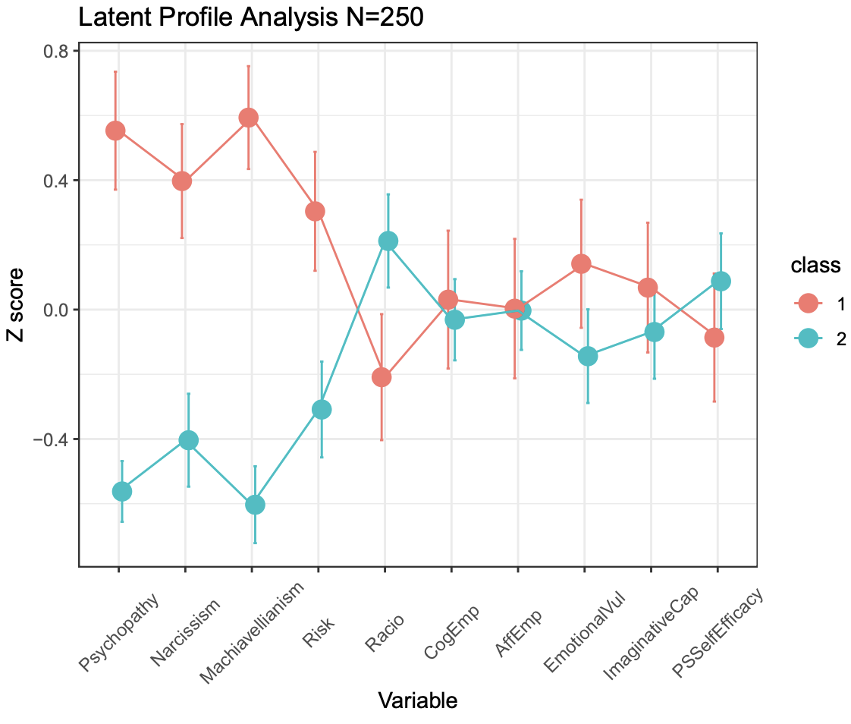
THE RELATIONSHIP BETWEEN RISK, THE DARK TRIAD TRAITS, AND EMPATHY T. KORNILOVA, E. PAVLOVA, Y. KRASAVTSEVA
Lomonosov Moscow State University (Moscow, Russian Federation)
Empathy is generally viewed as a “positive” trait, while the Dark Triad traits are regarded as an unstable personality core and a “negative” side of a Dark personality. The perception of “readiness to risk” is less univocal, as risk plays a role in both courage and questionable behavior.
We posed the following research questions:
Is risk linked to empathy and the Dark Triad traits?
Which traits help differentiate between participants with contrasting latent profiles (determined cumulatively for the specified personality variables)?
Participants (n = 250) were asked to fill in three questionnaires:
The Dirty Dozen (Jonason, Webster, 2010)
Personality Factors of Decision-making (Kornilova, 2003)
The Questionnaire of Cognitive and Affective Empathy (QCAE) (Reniers et al., 2011)
Correlation and Latent profile analysis (LPA) were performed.
Risk is linked to Machiavellianism, psychopathy, and decentration (positively) and to emotion contagion and affective empathy (negatively).
Rationality is positively correlated with cognitive empathy. Machiavellianism correlates negatively with rationality and online simulation (a cognitive empathy subscale); psychopathy is also negatively linked to empathy subscales. Narcissism is positively correlated with several empathy subscales.
LPA established two latent profiles in the data: the smallest BIC value was obtained for the model with two profiles (log-likelihood: -3204.013, df=77, BIC=-6833; VEE).
Analysis of means revealed that Class 1 was characterized by significantly higher Dark Triad values and higher Risk, whereas Class 2 was characterized by lower Dark Triad traits, lower Risk, and higher Rationality (see Figure 1).
The Dark Triad traits and Risk are the more discriminative variables, while Empathy subscales do not help distinguish between the two classes of participants.
The study was supported by the Russian Foundation for Basic Research, project 19-29-07069

