Slide 1
Integration of soil and landscape information for sustainable soil and landscape management and protection: a possible solution
Aleksandra A. Nikiforova¹, Maria E. Fleis², Klim V. Kim³, Nina K. Belyonova³, Yulia K. Kim³
¹ Faculty of Soil Science, Lomonosov Moscow State University, Russian Federation
² Institute of Geography RAS, Moscow, Russian Federation
³ Central Economics and Mathematics Institute RAS, Moscow, Russian Federation

Slide 2
The need to integrate soil and landscape information into a single system
Current soil and landscape information is not harmonized, inconsistent and sometimes contradictory.
The main reason for this is:
the lack of universal (global, basic) classification systems of soils and landscapes.
The main reason for this is:
the lack of theoretical substantiation for these classification systems.
The main reason for this is:
the lack of the systems approach to soils and landscapes and, above all,
the lack of their system definitions.

Slide 3
What is the systems approach?
The systems approach is
considering objects as systems and at the same time
as system elements (Bertalanffy, 1968)
• Material systems, which are soils and landscapes, are structurally organized integral unities of interrelated and interdependent elements with emergent properties
• System elements are minimum components of the system with relatively homogeneous properties, representing the division limit of the system.
Elements of material systems are also material.
• Emergent property of the system is a property that arises as a result of the interconnection and interaction of its elements

Slide 4
Why the systems approach?
By focusing on synthesis, the systems approach serves as a vehicle to overcome knowledge fragmentation and helps to find new ways to solve theoretical and practical problems (Jackson et al., 2010; Mobus and Kalton, 2014; Skyttner, 2006).
“Often, even an old, seemingly dead-end problem can be solved if it is subjected to a systemic consideration” (Yudin, 1973).
The systems approach should play a decisive role in solving such an ambitious task as the integration of soil and landscape information

Slide 5
How to use the systems approach
to integrate soil and landscape information?
1. To give the system definitions of natural soils and landscapes
2. To use these definitions for the theoretical substantiation of a hierarchical genetic (not morphological)* and evolutionary** classification system of soils and landscapes
3. To develop this classification system in the process of multiscale soil-landscape GIS mapping
4. To link a decision-making system for sustainable soil and landscape management and protection to the developed classification system and multiscale maps
* The genetic soil classification systems are those in which soils are subdivided depending on the conditions of their formation (soil-forming factors). The morphological soil classification systems are those in which soils are subdivided depending on the diagnostic properties of soils.
** The evolutionary classification systems are those in which soils are subdivided depending on the main stages of their formation and development over time.

Slide 6
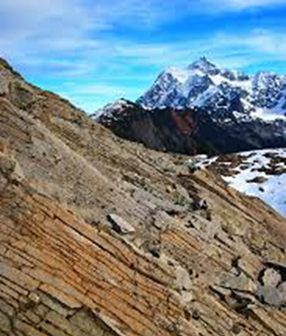
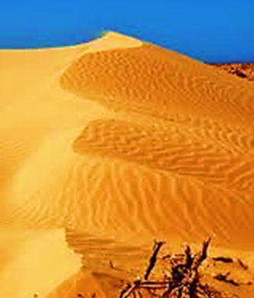
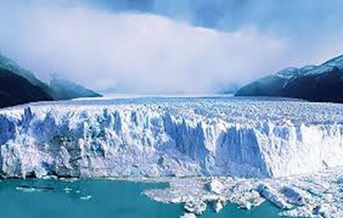
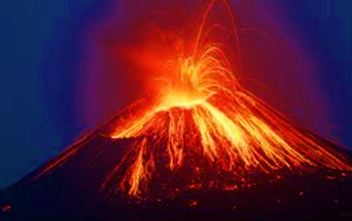
The truncated system definitions of natural soils and landscapes
Natural soils are structurally organized, evolving material systems and, at the same time, derived elements of higher-order systems - landscapes.
Natural soils arise only as a result of the interaction of basic landscape elements - parent material, air, natural waters, living and dead organisms.
Natural landscapes are structurally organized, evolving material systems consisting of interrelated and interdependent basic elements and one derived element - soils.
Landscapes do not exist without basic elements.
Landscapes without soils:
Soil and landscape systems are homogeneous and consist of homogeneous elements

Slide 7
In fact, the system definition of soils was given by V.V. Dokuchaev (1886),
although it does not correspond to the terminology of the systems approach.
This definition sounds like this:
Soils are natural bodies,
which are rock horizons
found on the surface of the earth and near it
and more or less altered as a result of
the combined action of
water, air and various types of living and dead organisms.

Slide 8
Emergent properties of natural soils and landscapes as systems
An emergent property of soils is the biogenic accumulation of chemical elements under the influence of vegetation, which largely ensures and maintains their fertility.
An emergent property of landscapes is favorable conditions for the existence of life on Earth.
! Since all soils, like all landscapes, have one emergent property,
they are located at the same hierarchical level
in the systems hierarchy.
At the same time, soils in comparison with landscapes
are systems of a lower order.

Slide 9
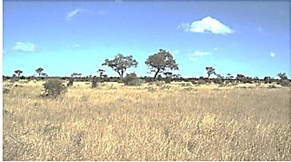
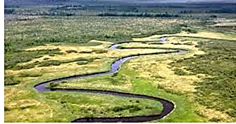
Vertical structure of landscapes:
the order of the arrangement of horizontal layers of its elements relative to each other in a vertical section, affecting the interaction and, as a consequence, the properties of landscapes and landscape elements.
___________________________________________________
! The boundaries of natural soils and landscapes coincide.
! Natural landscapes are the basis of natural-anthropogenic landscapes.
Air | Soils | Parent material
Air | Water | Soils | Parent material
Air ↔ Water | Soils | Parent material

Slide 10
What is soil and landscape information ?
It follows from the system definitions of soils and landscapes that soil and landscape information includes:
• Information on the properties of soils and how they change over time;
• Information on the properties of landscapes, which include these soils,
(stability and type of vertical landscape structure), and how they change over time;
• Information on the properties of the basic landscape elements that determine the properties of associated soils and how they change over time.
! Information on the properties of landscapes
and their basic elements = Information on soil-forming conditions !
Integration of soil information is carried out
when developing
A Soil-Landscape Classification System

Slide 11
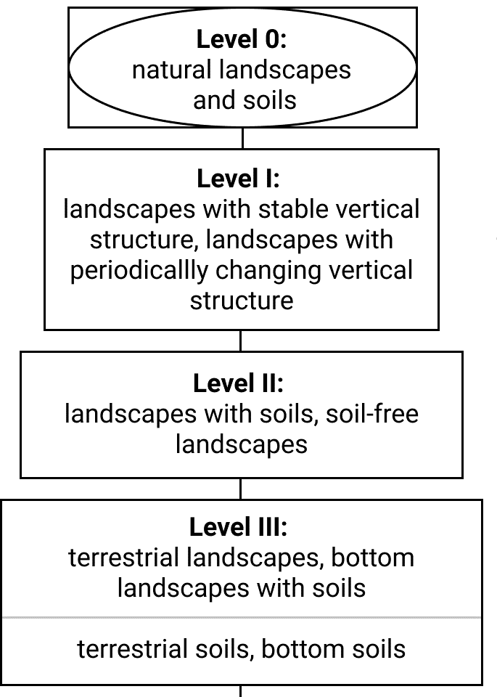
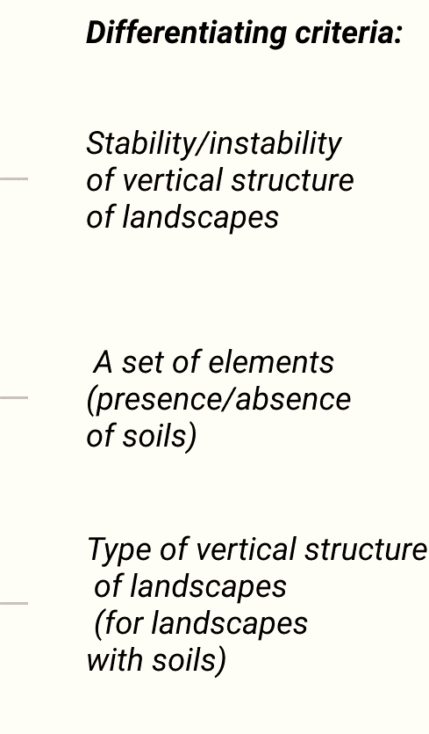
Basic principles of the Soil-Landscape Classification System (the SLCS):
• The objects of the SLCS are natural landscapes (as systems) and natural soils (as derived elements of landscape systems)
• The sequential division of landscapes is accompanied by a simultaneous sequential division of soils
• The division of landscapes and soils continues until landscapes and soils with relatively homogeneous properties are obtained
• In the SLCS differentiating and diagnostic criteria are separated
…
The example of part of one of the branches of the SLCS

Slide 12
• At the first three levels, the differentiating criteria are the essential properties of landscapes as wholes,
and at lower levels, they are the essential properties of the basic landscape elements, which determine the essential properties of the associated soils
• At each stage of division of landscapes and soils, only one differentiating criterion is used
• The SLCS is developed as a complete hierarchy (that is, with a full set of hierarchical levels) from general to particular and from top to bottom
• For the SLCS to be evolutionary, it must have a time axis of coordinates
When developing the basic principles of classification, contemporary theories of classification were used
! Through these principles the SLCS reflects the relationship between soils and landscapes !

Slide 13
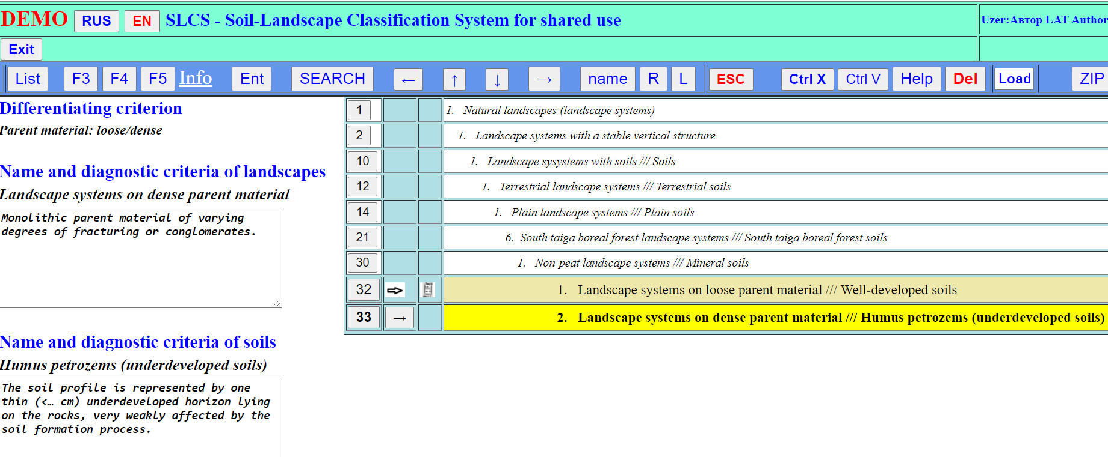
The SLCS is being developed on a specially designed website
https://slcs-2021.ru/
A fragment of the classification tree
The computer version of the SLCS for shared use allows you to enter, store, organize and analyze information without writing additional programs
The button INFO - clicking on it you can get additional information in the future

Slide 14
Examples of additional information
that can be linked to soil and landscape classes
…

Slide 15
Multiscale soil-landscape maps
The SLCS is being developed in the process of multiscale soil-landscape GIS mapping
A system of harmonized maps at various scale ranges (from global to local) with a single classification base (the SLCS), which are
linked to base coordinate systems
and selected geographic bases,
and automatically obtained from integrated polygonal data layers
Integrated polygonal data layers at various scale ranges are created
based on the expert analysis and integration of soil and landscape information

Slide 16
The relationship between integrated polygonal data layers
at four scale ranges
1: 60,000,000 - 1: 80,000,000
1:15,000,000 - 1: 25,000,000
1: 4,000,000 - 1: 10,000,000
1,000,000 - 2,500,000

Slide 17
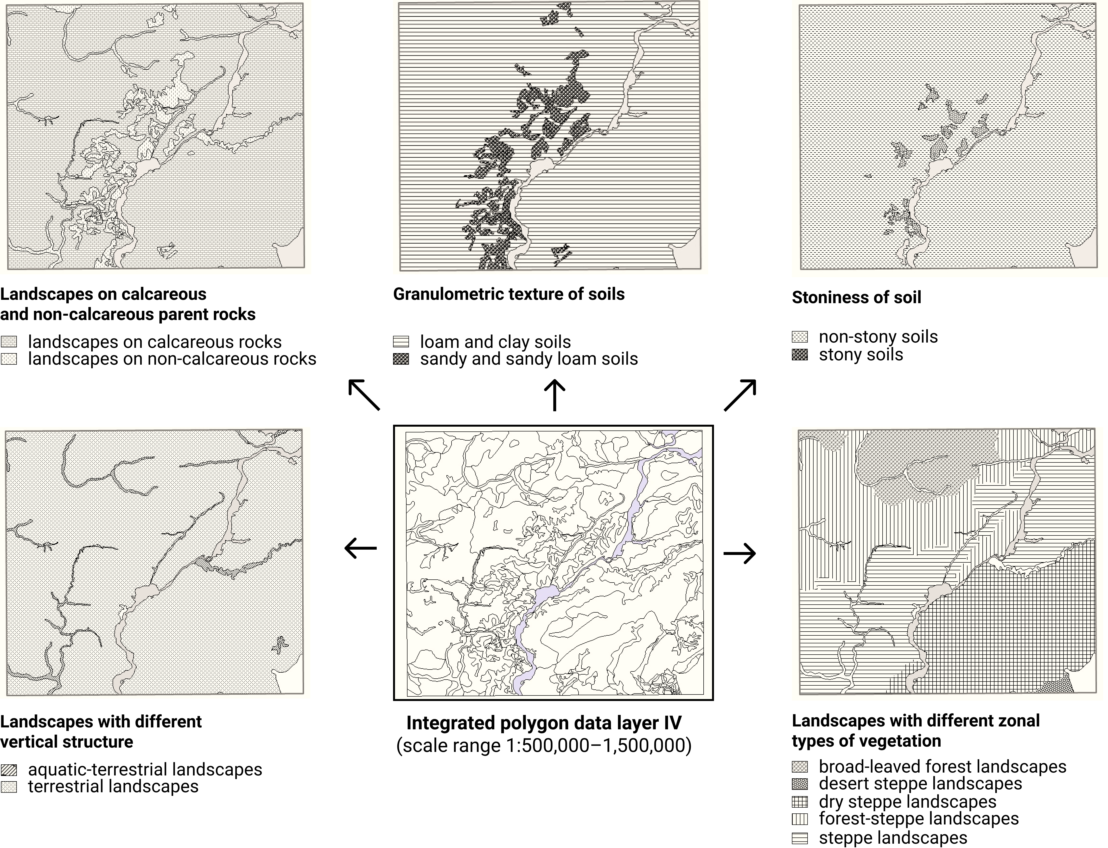
Example of fragments of multiscale soil-landscape maps generated automatically
from one integrated polygonal data layer:
These are maps of essential properties of soils, landscapes and basic landscape elements

Slide 18
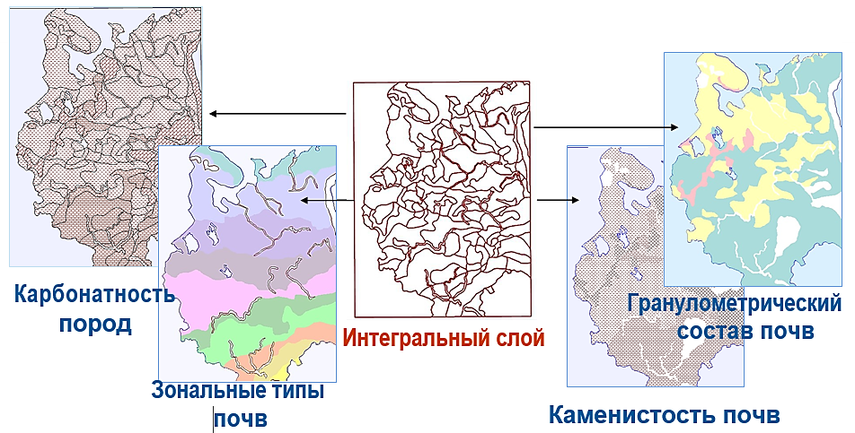
Another example:
Calcareousness
of parent material
Soil texture
Integrated polygonal data layer II
Zonal types of vegetation
Soil stoniness

Slide 19
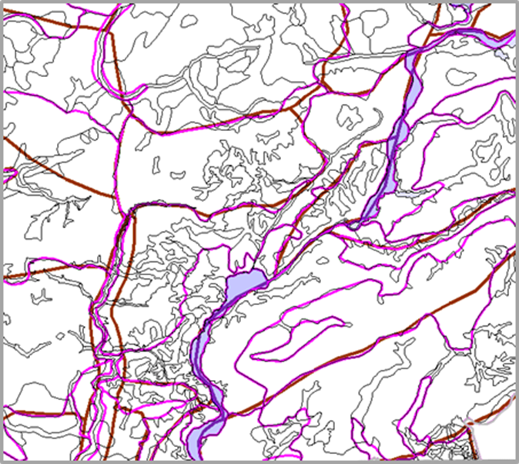
The relationship between integrated polygon data layers
boundaries of polygons of the layer
at a scale range
1: 15,000,000 - 1: 25,000,000
boundaries of polygons of the layer
at a scale range
1: 4,000,000 - 1: 10,000,000
boundaries of polygons of the layer
at a scale range
1: 500,000 - 1: 1,500,000

Slide 20
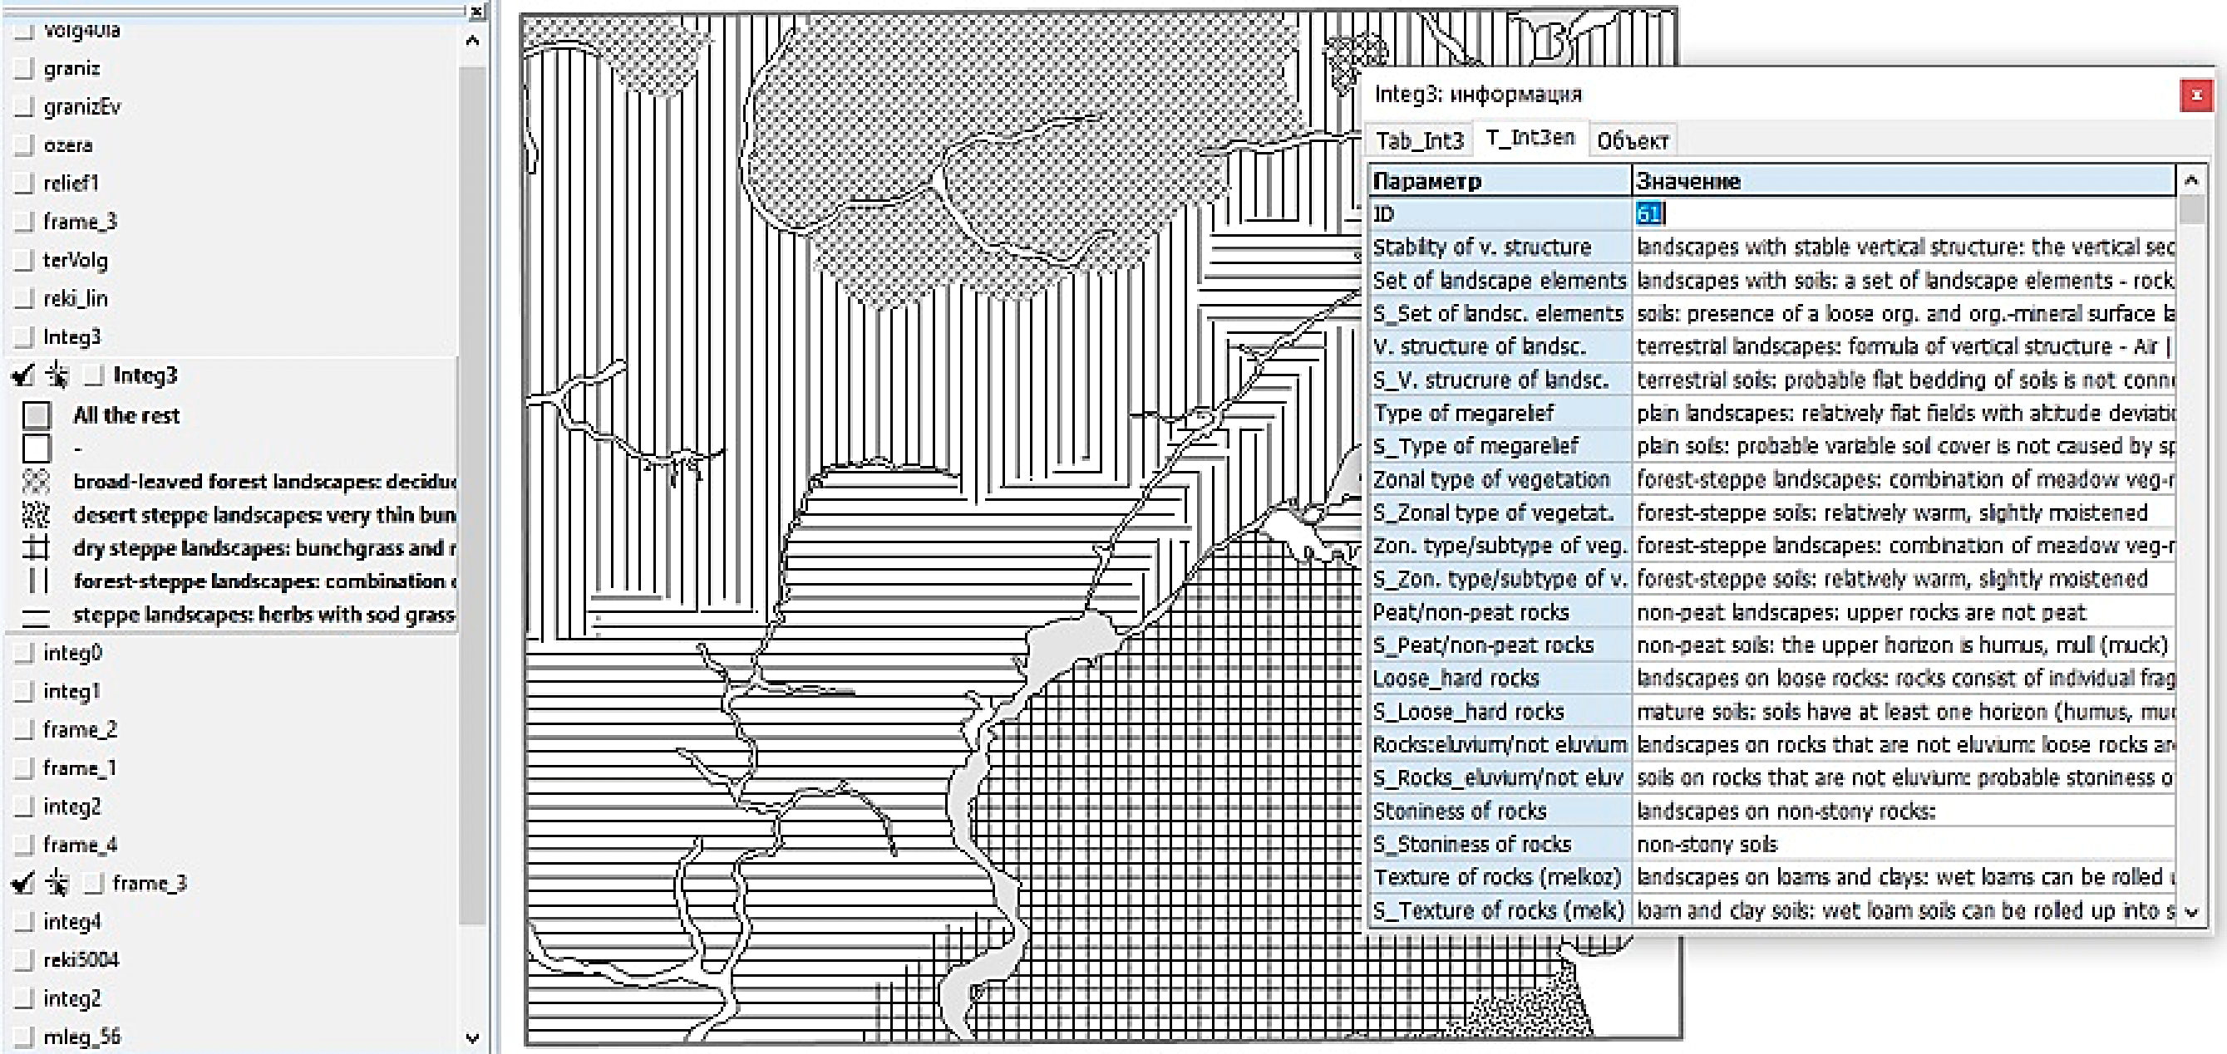
Multiscale soil-landscape maps are highly informative and reflect
the relationship between soils and landscapes
•

Slide 21
Types of soil and landscape information integration
• Thematic integration - the creating of a hierarchical genetic soil-landscape classification system
• Temporal integration - integrating of information on soil and landscape evolution; part of thematic integration
• Spatial integration - the transformation of soil and landscape spatial data of a certain scale range into a base coordinate system

Slide 22
• Geographic integration - the binding of soil and landscape spatial data of a certain scale range to a single geographic basis
• Horizontal integration - the creating of world soil and landscape maps at a certain scale range
• Vertical integration - the creating of interrelated multiscale soil-landscape maps at all scale ranges
All these types of integration are interconnected
and, therefore,
should be carried out within the framework of a single project

Slide 23
The creation of
(1) a hierarchical genetic, evolutionary Soil-Landscape Classification System,
(2) a system of multiscale soil-landscape maps
and on this basis
(3) a hierarchical decision-making system for sustainable soil and landscape management and protection
will mean
the global integration of soil and landscape information

Slide 24
Based on the research results, the following articles have been published:
Nikiforova, A.A., Basian, O., Fleis, M.E., Nyrtsov, M.V., Khropov, A.G., 2019. Theoretical development of a natural soil-landscape classification system: an interdisciplinary approach. Catena 177 (6), 238-45.
Nikiforova, A.A., Fleis, M.E., Nyrtsov, M.V., Kazantsev, N.N., Kim, K.V., Belyonova, N.K., Kim, J.K., 2020. Problems of modern soil mapping and ways to solve them (a review). Catena 195 (12), 104885.
Nikiforova, A.A., 2019. Soil classification (a review). Knowl. Organ. 46 (6), 467-488.
Nikiforova, A.A., Fleis, M.E., 2018. A universal soil classification system from the perspective of the General Theory of Classification: a review. Bull. Geogr. Phys. Geogr. Ser. 14, 5–13.
Nikiforova, A.A. and Barton, J. The systems approach (a review). Knowl. Organ.
Nikiforova, A.A. et al. The systems approach in soil science
and landscape science (a review).
The following manuscripts have been prepared for publication:

Slide 25
Thank you very much for your attention !

