Slide 1
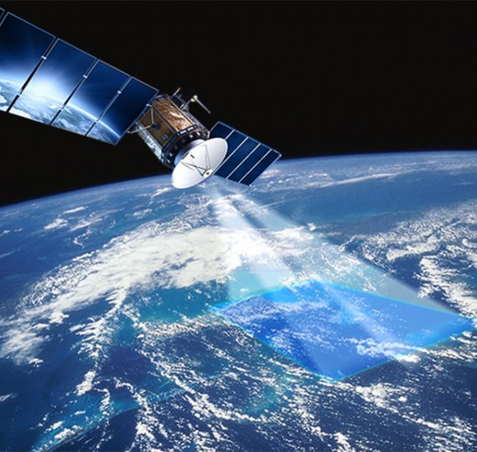
Svetlana POPOVA, Mariam YUZBASHYAN, Zhan ZHANG
The Economic Impact
of National Space Legislation:
Approaches to Comparative Analysis

Slide 2
APPROACHES & METHODS
Analysis of the evolution of national space policy, space law, and space economy (diachronic analysis)
Synchronous analysis of national space policy, space law, and space economy
Synchronous /diachronic comparative analysis of space policy, space law, and space economy of group of countries
GOVERNANCE
LEGISLATION
SPACE
ECONOMY

Slide 3
XX CENTURY: ECONOMIC IMPACT OF THE LAW
The U.S. Commercial Satellite Act has generated $1 billion in revenue in 30 years
Space Agencies of 17 countries joined the project and created an international communications consortium
IntelSat
$ 89 billion – revenue of the USA private sector
of satellite communications and television
2015
1964
$ 90 billion – world income of the private sector of satellite communications and television
The U.S. Commercial Satellite Act was adopted
The emergence of systems of geostationary communication satellites, space navigation and satellite television
2003
August 31,1962
1965-1980
1960
1965
1970
1975
1980
1985
1990
1995
2000
2005
2010
1963
Institution of the first public-private operator ComSat
1965
Early 1990s
2005
Launch of the first commercial international communications satellite– IntelSat I (EarlyBird)
ComSat's revenue from satellite broadcasting
of TV programs has grown to $ 1 billion per year
IntelSat was privatized for $ 3.1 billion
2

Slide 4
XXI CENTURY: ECONOMIC IMPACT OF THE LAW
Luxembourg's Law on the Exploration and Use of Space Resources
has generated more than $1 billion in revenue in less than 1 year
Пример воздействия политико-правовых регуляторов -2
Luxembourg - 2022
Population - 648,124 people
GDP per capita – $ 118.680,00
Luxembourg’s Law on the Exploration
and Use of Space Resources
Launch of the SpaceResources.lu
Initiative
July 20, 2017
Today, the Luxembourg’s space ecosystem is home
to more than 70 public and private players in the space sector employing more than 1400 people
February, 2016
216
2017
2018
2016 | 2017 | 2018 | 2019 | 2020 | 2021
December, 2016
Space Sector of Luxembourg’s Economy – 4 % GDP
Space Sector of Luxembourg’s Economy– 0 %
December, 2017
Space Sector of Luxembourg’s Economy – 2 % GDP

Slide 5
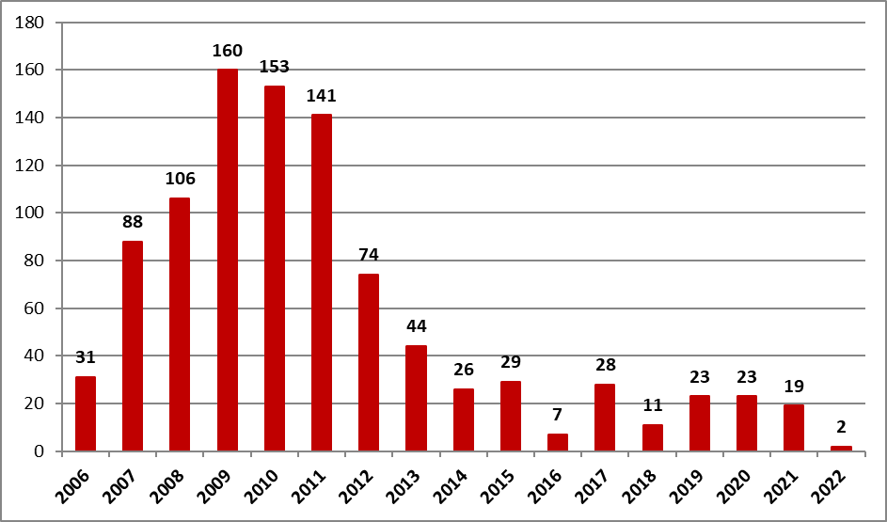
October 20, 2023
AFFECT of the LAWS’ inconsistency
Number of valid licenses (by year of receipt)*
Decree of the RF Government No. 298 of March 18, 2020 (as amended of Feb. 14, 2022) "On licensing of space activities"
The RF Law No. 5663-1 "On Space Activities" dated 20.08.1993 (with amendments, latest one of 13.06.2023 No 241-FZ)
Art. 10, par. 2. Mandatory certification or declaration of conformity of space technology is carried out in accordance with the procedure established by the legislation of the Russian Federation on technical regulation
Federal Law "On Technical Regulation" dated 27.12.2002
(with amendments, latest one of 02.07.2021 No 351-FZ)
Article 5.6. The specifics of technical regulation in the field of space activities are established by the RF Law No. 5663-1 "On Space Activities" dated 20.08.1993
Total – 965 valid licenses
Source: Roscosmos website

Slide 6
USA
RF
China
EU
UK
Japan
Kazakhstan
National Legal Acts Supporting COMMERCIAL SPACE ACTIVITIES
France: Loi n° 2008-518 du 3 juin 2008
relative aux opérations spatiales
Luxembourg: Loi du 20.07.2017 sur l’exploration
et l’utilisation des ressources de l’espace
RF No. 147-FZ of 29.11.1996 "On Amendments
and Additions to the Law of the RF "On Space Activities"".
The Civil Code of the RF, Art. 1207
(included in the Civil Code by the Federal Law
of 30.09.2013 N 260-FZ)
Decree of the RF Government
No. 168 of 02.14.2022
U.S. Communications
Satellite Act of 1962
Order of the RF Government
No. 22-r of 14.01.2023
U.S. Commercial Space
Launch Act of 1984
Law of the Republic of Kazakhstan 06.01.2012 No. 528-IV "On Space activities"
U.K. Space Industry Act of 2018
U.S. Commercial Space Launch
Act Amendments of 1988
The Space Activity Act
of Japan No. 76 of 2016
U.K. The Space Industry
Regulations of 2021
COSTIND Launching Permits
Measures (Order no. 12) of 2002
Public Law 101-580
Inventions in Outer Space of 1990
The Remote Sensing Act
of Japan No. 77 of 2016
The Space Resources Act
of Japan No. 83 of 2021
U.S. Commercial Space Launch
Amendments Act of 2004
Land Remote Sensing
Policy Act of 1992
U.S. Commercial Space Launch
Competitiveness Act of 2015
Executive Order of the President
of the U.S. 13914 of 2020
Telecommunications
Act of 1996
1962 1984 1988 1990 1992 1996 2002 2004 2008 2012 2013 2015 2016 2017 2018 2020 2021 2022 2023

Slide 7
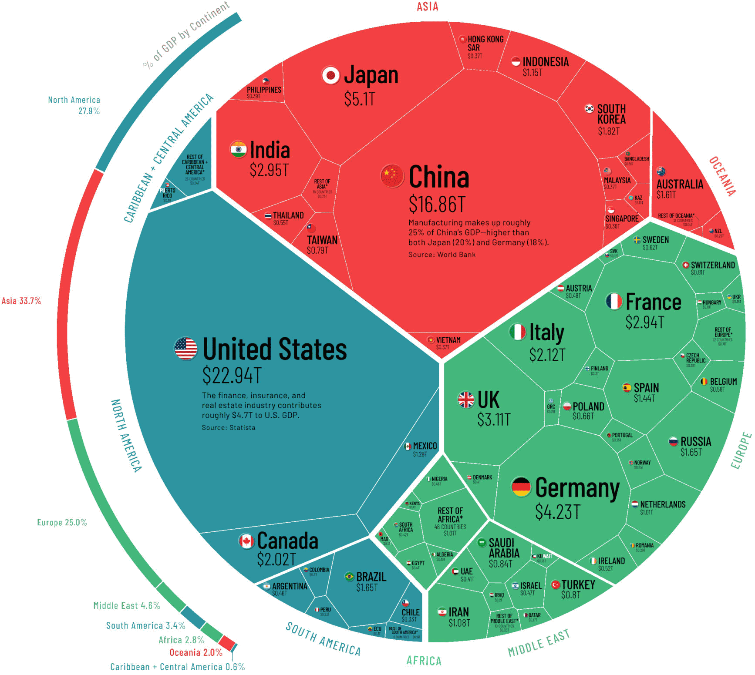
Volume of legal support VS. SIZE of commercial space Economy
LAWS FOR Commercial Space ECONOMY
The size of the NATIONAL economy
Country | Acts
USA | 9
RUSSIA | 4
CHINA | 1
EU | 2
UK | 2
JAPAN | 3
INDIA | 1*
$ 211,6 B (2021)
$ 160,1 B (2020)
Commercial Space Economy
USA
China
* India has no national laws in support of commercial space activities,
but the Indian Space Policy refers to the national vision of legal policy
$211.6 B of gross output exceeds the GDP (2022) of Belarus ($208B),
Slovakia ($203B) as well as other 128 countries

Slide 8
National Acts Supporting Development
of Specific Domains in Commercial Space Activities
Satellite Communications
United States (1962; 1996)
Russia (2023)
Inventions in Outer Space
United States (1990)
United States (2015); Luxembourg (2017)
UAE (2019); Japan (2021); India (2023)
Exploration and Use of Space Resources
Space Launch Activities
United States (1992)
Global Navigation Satellite System
Space Tourism / Private Commercial Spaceflight
Remote Sensing
United States (1988, 2004; 2015)
China (2002); US (2010)
United States (2004; 2015)
Japan (2016); Russia (2023)
China (2002); France (2008)

Slide 9
Specific National Legislative Incentive Measures
for Development of Commercial Space Activities
National Laws in Support of Commercial Development of Specific Space Activity Domains and Directions
Limitation of the Amount of the Required Liability Insurance (against Third Parties) or Other Form of Demonstration of Financial Responsibility; and Cross-waiver of Liability
Legal Framework for Protection of Inventions made, sold or used in Outer Space
Determination of Law Applicable to Private Property Transactions with Space Objects, including in Outer Space
Removal of Excessive Legal and Administrative Obstacles in Receiving Authorization for Space Activities
Financial Incentives: Tax Breaks or Governmental Funding
Laws and Policies Outpacing Rise and Development of Specific Domains in Outer Space Activities
1
2
3
4
5
6
7

Slide 10
1
Adoption of National Laws in Support
of Commercial Development of Specific Space Activity Domains and Directions
2
Limitation of the Amount of the Required Liability Insurance (against Third Parties) or Other Form of Demonstration of Financial Responsibility;
and Cross-waiver of Liability
Laws with full range measures for the economically developed and viable sectors (remote sensing, communication satellites, launch services etc.)
Laws with basic legal mechanisms aiming at future regulation when the activities become feasible (e.g. use of space resources)
National laws determine the amounts of limitation (more efficient)
The U.S. Public Law 100-657—Nov. 15, 1988 (with amendments)
National laws do not determine specific amounts, but generally refer to MPL (Maximum Probable Loss) or MIR (Modelled Insurance Requirement) approaches for calculation of the required amount of liability insurance or other form of demonstration of financial responsibility
(less efficient)
France (2008); Japan (2016); UK (2018);
Australia (2018,2019); UAE (2019)

Slide 11
3
Legal Framework for Protection
of Inventions made, sold or used
in Outer Space
4
Removal of Excessive Legal and Administrative Obstacles in Receiving Authorization for Space Activities
USA (1990)
USA (1988, 2004); Russia (2022)
4
Determination of Law Applicable
to Private Property Transactions
with Space Objects, including in Outer Space
5
Financial Incentives: Tax Breaks
or Governmental Funding
Russia (2013)
e.g. USA (2004); Luxembourg (2017);
Russia (2023)

Slide 12
7
Laws and Policies Outpacing Rise and Development of Specific Domains
in Outer Space Activities
USA (1962, 1984, 1988, 1990, 2004, 2015)
National legal regulation:
either surpasses the time when specific activities in outer space become feasible
1962 – communications satellite
1990 – inventions in outer space
2015 – space resources use
or enacted in support of privatization and commercialization the public segment of space economy: 1984,1988, 2004, 2015
(commercial space launch)
Space Resources Commercial Use
Luxembourg (Law of 2017),
Japan (Law of 2019)
UAE (Law of 2021)
India (Indian Space Policy - 2023 )

Slide 13
National Space Policies: new challenges - new strategies
2013
Russia: The Main Provisions of the Foundations for State Policy of the Russian Federation in the Field of Space Activity for the Period until 2030 and Further Perspective (adopted by the RF President on April 19, 2013, No Pr-906)
2016
Russia: Federal Space Programme of Russia for the Period 2016-2025 (adopted by the Decree of the RF Government on March 23, 2016, No 230)
2020
USA: National Space Policy of the United States of America, issued by President Donald J. Trump on December 9, 2020
Japan: Basic Plan on Space Policy 2020
2021
2022
Germany: Space Strategy included in Federal Government Report on the High-Tech Strategy 2025
China: China's Space Program: A 2021 Perspective (released January 28, 2021 by the State Council Information Office)
EU: The EU Space Strategy for Security and Defense
UK: Defense Space Strategy: Operationalizing the Space Domain (February, 2021)
UK: The National Space Strategy (September, 2021)
2023
Japan: Space Security Policy (adopted on June 13, 2023)
India: Indian Space Policy – 2023

Slide 14
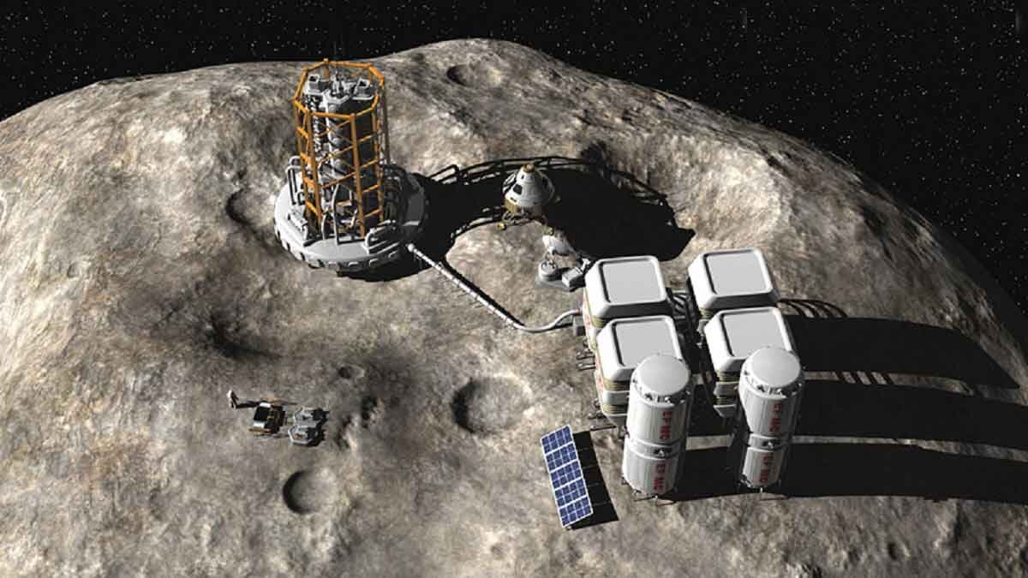
SPACE LEGISLATION: Long history VS. NEW DEMANDs
Late 1950s - discussions on the possibility of national or private appropriation of space resources started long before the adoption of the Outer Space Treaty (1967)
1979 – Prof. Yuriy M. Kolosov (Russia) relied in legal assessments on the future transition to "material production" in Space (Space 3.0)
Today, the idea of exploring planets, asteroids, space resources, as well as in-space economy is not a fantasy
The Legal Science foresaw new demands of space economy long before they appeared

Slide 15
THANK YOU FOR YOUR ATTENTION !
+79859997166
Center for Comparative Law
Shenzhen MSU-BIT University
cpi_2002_1@yahoo.co.uk
October 20, 2023

