Slide 2
Maria Konyushkova, Tatyana Yakusheva
ECFS, Moscow, Russia
Eurasian Centre for Food Security (ECFS) and its Network in Food Security and Nutrition: Experiences and achievements

Slide 3
L’Aquila Food Security Initiative
ECFS was founded in 2011 as a response of the Russian Federation to the L’Aquila Food Security Initiative which was launched at the 2009 G-8 Summit in L’Aquila, Italy
The Initiative prioritizes food security and agricultural sustainability as major policy developments at the global, regional and national levels. In addition to G8 members, more than 40 countries supported the Initiative, as well as leading international agencies involved in agriculture, food security and nutrition.
http://www.g8italia2009.it/static/G8_Allegato/LAquila_Joint_Statement_on_Global_Food_Security[1],0.pdf

Slide 4
Eurasian Center for Food Security
Edimus, ut vivamus!
Vision: Food security through sustainable management of natural resources and food market regulation
Mission: Encourage and coordinate collective action to strengthening food security in Eurasia through research and development
http://www.g8italia2009.it/static/G8_Allegato/LAquila_Joint_Statement_on_Global_Food_Security[1],0.pdf

Slide 5
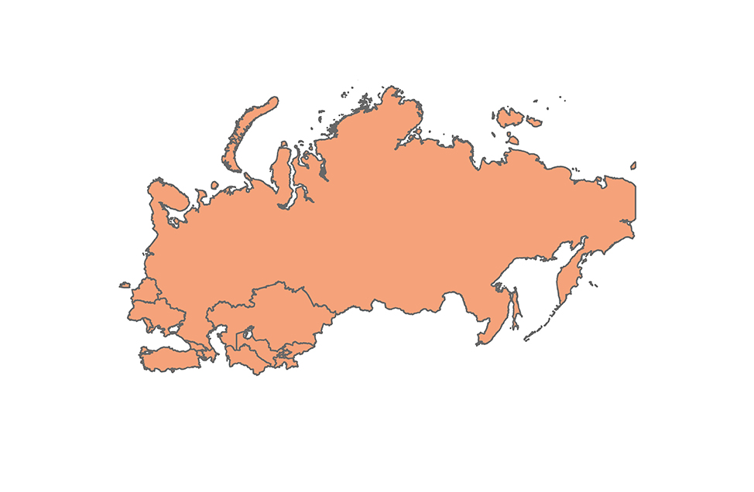
Eurasian region (13 countries)
Total area – 22 922 862 km² (17% of global)
Population – 371.2 mln. (6% of global)
Area (ths. km²) and permanent population (mln.) as at the beginning of 2017, by countries
Belarus
Area: 207.6
Population: 9.5
Ukraine
Area: 603.6
Population: 42.4
Moldova
Area: 33.8
Population: 3.6
Russia
Area: 17 000
Population: 146.1
Kazakhstan
Area: 2 725
Population: 17.8
Turkey
Area: 783.6
Population: 81.0
Kyrgyzstan
Area: 199.9
Population: 6,1
Turkmenistan
Area: 491.2
Population: 6.7
Armenia
Area: 29.7
Population: 3.0
Georgia
Area: 69.7
Population: 3.7
Azerbaijan
Area: 86.6
Population: 9.8
Uzbekistan
Area: 449.0
Population: 32.1
Tajikistan
Area: 143.1
Population: 8.7

Slide 6
Areas of activity
Research
Education
and extension
Expertise
Coordination of intergovernmental projects

Slide 7
-- International Conference on Eurasian Food Security Network and Eurasian Soil Partnership. Moscow, November 19-20, 2013 -- Online Consultation on “Network and Partnerships in the area of Food Security” hosted by ECFS and the World Bank, January 2016 -- International Conference on Eurasian Food Security Network and Eurasian Soil Partnership, Bishkek, February 29-March 2, 2016
The activity of the network

Slide 8
ECFS portal: ecfs.msu.ru
Notes:
Основными достижениями являются:
- Информационно-образовательный портал, на котором представлены ресурсы в области продовольственной безопасности, информация об исследованиях в этой области (МГУ и партнеров), новостная лента, события и мероприятия, отчеты членов коллектива

Slide 9
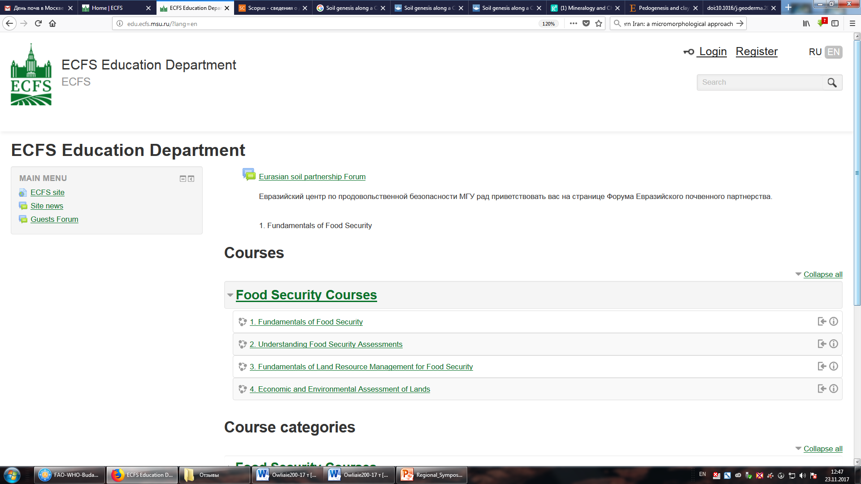
Educational platform of ECFS edu.ecfs.msu.ru
Notes:
Достижения (продолжение) – образовательная платформа дистанционного образования.
Текущая деятельность (on-going activity):
Разработка дистанционных курсов
Проведение обучения
Подготовка дистанционных преподавателей

Slide 10
ECFS Newsletter (28 issues):
2012-2016 – quarterly
Since 2017 – monthly
Russian / English languages
Notes:
Рассказать про содержание бюллетеня: анонсы о предстоящих и отчеты о прошедших мероприятиях, популярно-научные статьи, объявления о грантах и т.д.

Slide 11
Eurasian center for food security Bulletin statistics
Month | Sent | Bounces | Open rate,% (n) | Click Rate,% (n) | Did Not Open | Unsubscribed
April | 384 | 46 | 42,3 (145) | 35,7 (52) | 195 | 1
May | 1007 | 158 | 34 (285) | 37 (106) | 564 | 6
June | 988 | 125 | 32 (277) | 23,6 (65) | 588 | 0
July | 983 | 114 | 32 (276) | 24 (66) | 594 | 4
September | 1059 | 124 | 34 (320) | 25 (81) | 615 | 2
October | 1119 | 120 | 34 (333) | 36 (119) | 666 | 1

Slide 12
ECFS mailing list (more than 1,000 addresees)
International organizations (GSP, GFAR, IFAD, WFP, IFPRI, ICARDA, CYMMYT, IWMI, ICRAF,
CAREC, GIZ, IAMO, JRC, ZEF, UNICEF)
Ministries and federal agencies of different countries (Armenia, Azerbaijan, Belarus, Georgia, Kazakhstan, Kyrgyzstan, Moldova, Russia, Tajikistan, Turkmenistan,
Uzbekistan)
Research, education and nongovernmental organizations
experts and specialists in food security, nutrition, environmental protection, soil science, agriculture
Notes:
This is a potential partnership network with which we can work according to the directions described below

Slide 13
Our vision of network on food security and nutrition
The creation and support of the user-friendly environment for exchange and sharing of knowledge in the field of food security and nutrition in two main directions : education and expert consulting

Slide 14
Master’s programs developed by ECFS
on Agrofood management and Land and water resource management
Russian/English
(20 courses)
http://ecfs.msu.ru/ru/news/anons-distancionnyh-kursov-po-prodovolstvennoy-bezopasnosti-857
Notes:
Курсы на двух языках. Тематика курсов была разработана на базе оценки потребностей, проведенной на конференции партнеров центра. Запущен пилотный проект по обучению на 4 курсах, информация распространялась через партнерскую сеть, были набраны слушатели…

Slide 15
Case studies
Food security in Eurasia: 7 case studies in 4 countries
The response of governments and other decision-
making groups to past shocks and crises in
the food and agricultural systems in the country selected :
7 case studies in 4 countries
Sustainable land management in saline soils :
5 case studies in 5 countries
http://ecfs.msu.ru/en/resources/case-study-publication-food-security-eurasia-778
Notes:
Food security in Eurasia (published): 7 case studies in 4 countries
Reported at the Dushanbe conference: 7 case studies and 4 countries
Will be reported at the Tashkent EASP Plenary assembly: 5 case studies and 5 countries
Отметить, что требованием было участие эксперта из России и целевой страны (сотрудничество)

Slide 16
Next steps:
Education: the development of programs for continuing professional education what is very demanded due to the lack of expertise in this quite new areas of food security and nutrition
Expert-analytical activity: the development of really working and user-demanded network of experts on the basis of the ECFS portal (forums, online-consultations)
Development of case studies by experts and introducing them into educational process
-
Notes:
В доктринах о продовольственной безопасности большое значение придается аспекту образования. Основными задачами центра: образовательная, экспертно-аналитическая деятельность.
Что касается образования, судя по feedback, кроме магистерских программ очень востребованы в регионе программы по переподготовке и повышению кадров, т.к. Lack of expertise in the areas related to food security and nutrition.
Что касается экспертно-аналитической деятельности, один из ближайших шагов – это создание реально действующей и работающей сети экспертов на базе портала ECFS и налаживание форумов, в которых простые пользователи могли бы задавать вопросы и получать ответы от экспертов.
Третье: разработка кейсов экспертами и их использование в образовательном процессе

